Slide 1
Developing an Advanced LLM-Powered AI Chatbot
FINAL PRESSENTATION ENSF 609 & 610
Presented by Sadia Khan, Sanket Patel Om Patel and Jauhar Fathima

Slide 2
PROBLEM STATEMENT
Employees struggle to find information across multiple folders and systems.
Static websites lack interactivity and quick search capabilities.
Knowledge silos slow down collaboration.
Need for an intuitive, AI-powered solution to improve information access.

Slide 3
PROJECT OBJECTIVE
Build a user-friendly frontend for non-technical content management
Integrate an intuitive chatbot for seamless interaction
Use advanced LLMs for accurate, context-aware responses
Enable accurate information retrieval for automation tools and essential resources

Slide 4
CORE FEATURES & DELIVERABLES
Must Have
Nice to Have
✔ LLM Service Integration ✔ API Development using Fast API ✔ Accurate Information Retrieval by implementing a Vector Database and RAG ✔ Frontend Development to enable page management ✔ User Authentication & Security
✔ Chat history and transcript access. ✔ Theming and UI customization for branding. ✔ Dockerized deployment for scalability.

Slide 5
TECH STACK USED
Frontend: React.js
Backend: Fast API (Python)
Database: MongoDB
LLM: OpenAI GPT API
Information Retrieval: Chroma DB (Vector Database)
User Authentication & Security: Firebase Authentication

Slide 6
TECH STACK USED
Frontend: React.js
Backend: Fast API (Python)
Database: MongoDB
LLM: OpenAI GPT API
Information Retrieval: Chroma DB (Vector Database)
User Authentication & Security: Firebase Authentication
Why we chose this Stack?

Slide 7
TECH STACK USED
Frontend: React.js
Backend: Fast API (Python)
Database: MongoDB
LLM: OpenAI GPT API
Information Retrieval: Chroma DB (Vector Database)
User Authentication & Security: Firebase Authentication
Why we chose this Stack?
React.js → Fast, scalable, interactive UI; team expertise Fast API → Requested by industry partner; quick & efficient development MongoDB → Flexible NoSQL for chatbot interactions OpenAI GPT API → State-of-the-art accuracy and language understanding
ChromaDB → Open-source vector DB; supports semantic search (RAG)
User Authentication & Security → Ready-to-use methods; handles hashing & secure token mgmt.

Slide 8
PROJECT TIMELINE
Testing & optimization
Week 8
Week 6-7
UI/UX design, database setup
Deployment & finalization
Week 3-5
Week 1-2
LLM integration, API development

Slide 9
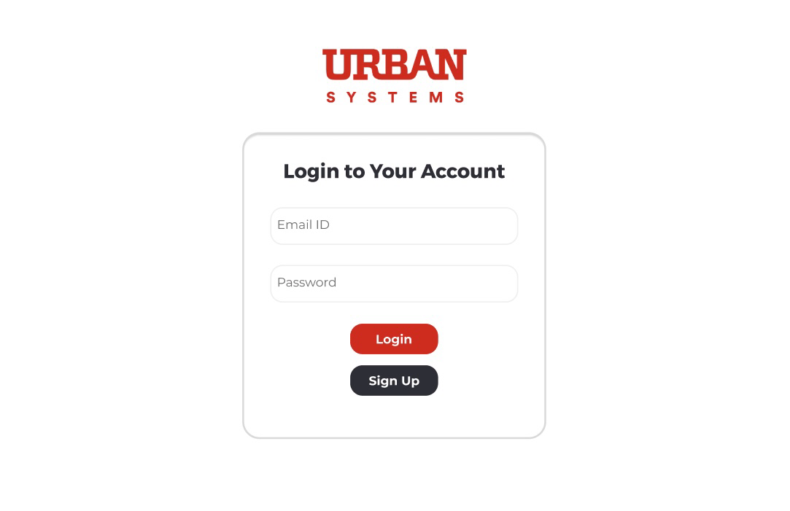
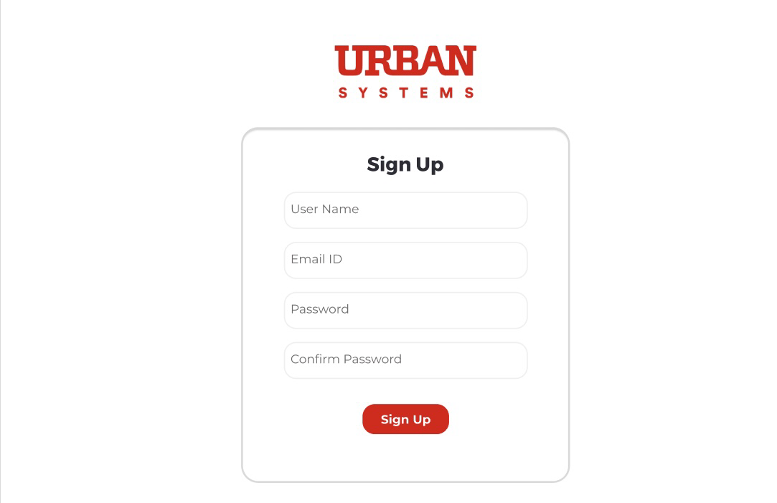
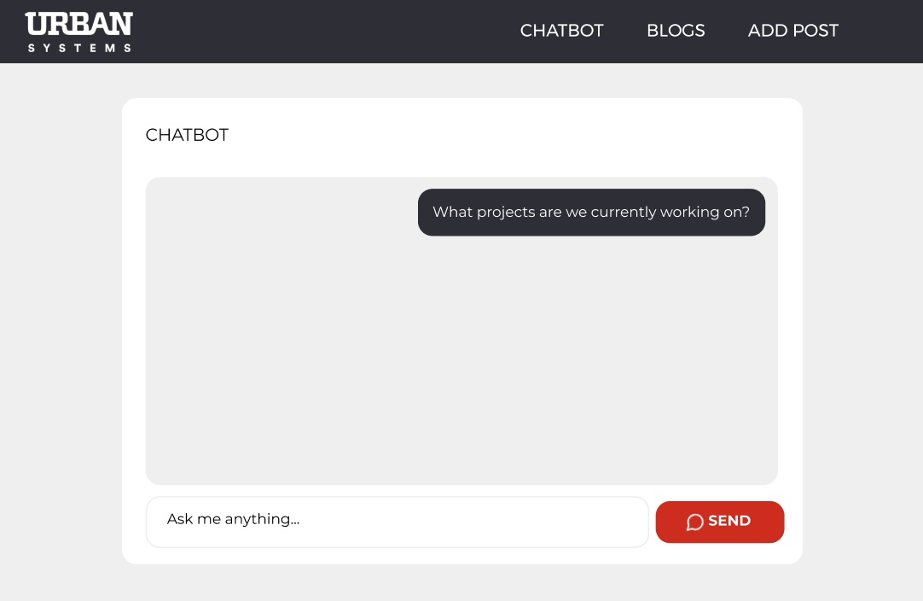
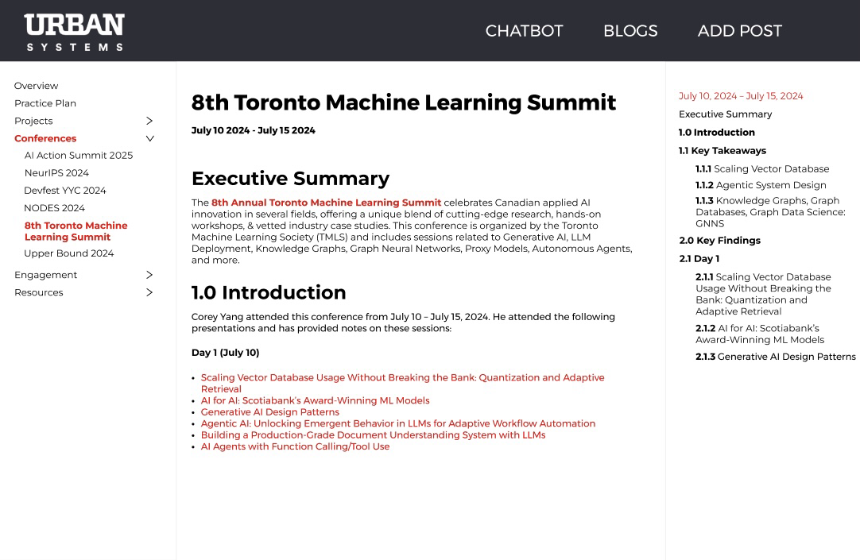
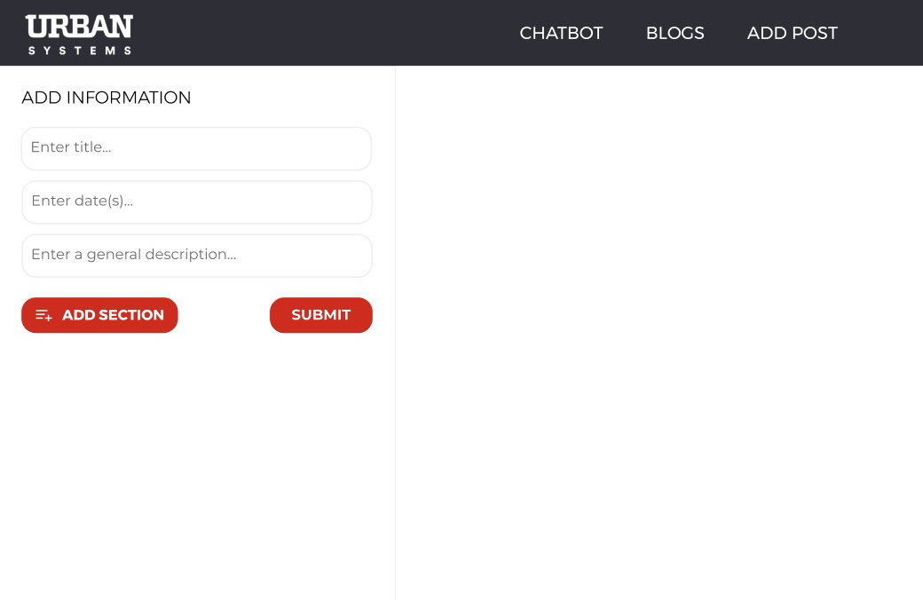
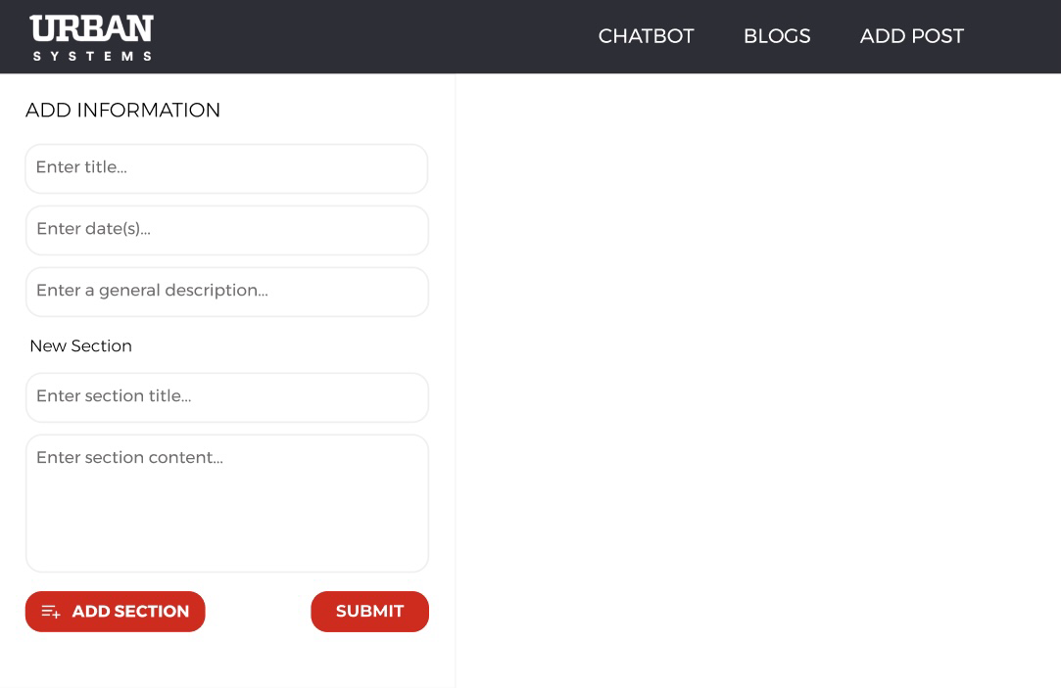
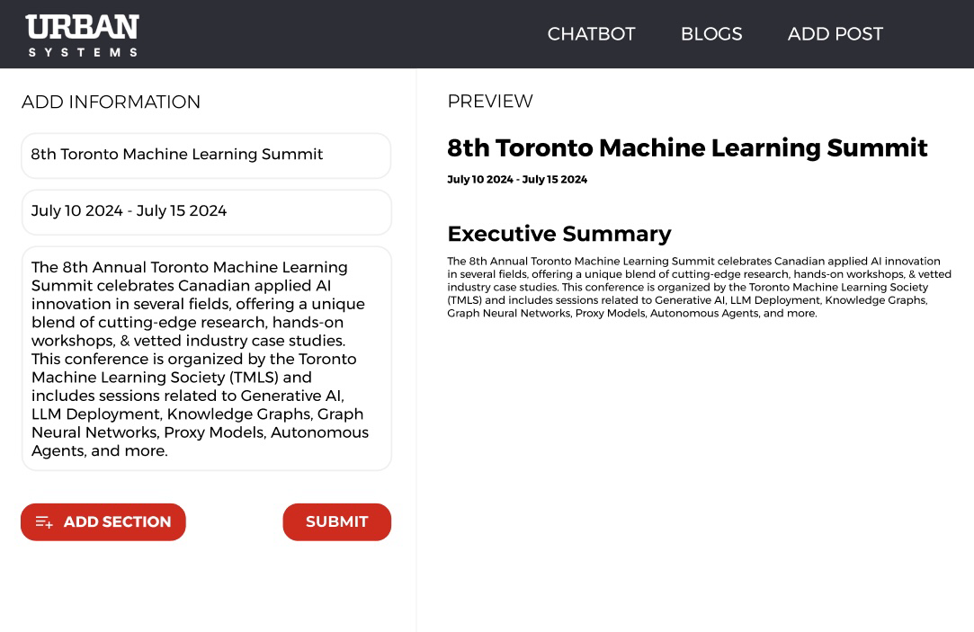
FIGMA PAGES

Slide 10
FINAL OUTCOMES & LESSONS LEARNED
Fully Integrated System React + FastAPI + MongoDB + ChromaDB + GPT
Enhanced Collaboration Non-technical staff can now easily update information Single chatbot interface centralizes knowledge retrieval
Key Lessons RAG significantly reduces LLM hallucinations Role-based access & OTP reset add critical security layers Rag and Memory Based both

Slide 11
LIVE DEMO

